Slide 1
Vertical Microphase Segregation in Polyelectrolyte Brushes:
A Systematic Study and Experimental Validation
Takashi Yokokura
PI: Prof. Rui Wang
September 14th, 10:00 am – 12:00 pm
Qualifying Exam

Slide 2
Intro

Slide 3



SCFT Build-up — System
What is the system made up of?
s
+
-
Interactions:
Elasticity (monomer-monomer)
Solubility (solvent-monomer)
Electrostatics (ion-monomer)
Assumptions:
+
-
s
+
Chains within brush identical
s
s
s
-
+
+
+
+
+
+
+
-
+
s
+
s
+
-
s
+
-
s
Ion correlations neglected
Finite ion volume neglected
s
+
+
s

Slide 4







SCFT Build-up — System
What is the end-result of the model?
111
s
+
Generate fields (equations) that all particles in the system experience
Continuous functions
Depend in a mean-field way on all other particles
“Self-consistent field theory” (SCFT)
-
+
-
s
+
s
s
s
-
+
+
+
+
+
+
+
-
+
s
+
s
+
-
111
111
+
s
-
s
s
+
+
s
(Andelman, 2006)

Slide 5





SCFT Build-up — Equations
Goal: Adapt framework for free polyelectrolyte in solution to model end-grafted protein brushes in solution
Interactions:
Elastic entropy following Gaussian statistics
Flory-Huggins 2-body interactions
Electrostatics, ignoring any correlations
Incompressibility

Slide 6

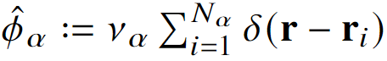
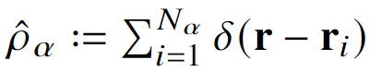

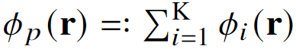
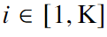



SCFT Build-up — Equations
Semicanonical partition function
Canonical in polymer, grand canonical in ions and solvent
Block copolymer formalism
Particle-to-field transformations
Hubbard-Stratonovich transformation
Saddle-point approximation

Slide 7






SCFT Build-up — Equations
Variational Free Energy
After statistical average over grafting surface (x-y plane)
Functional Minimization
SCF Equations

Slide 8
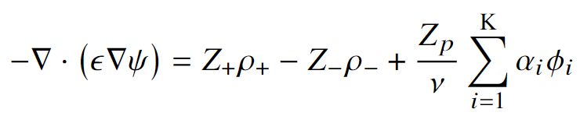

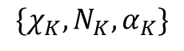
SCFT Build-up — Equations
SCF Equations, cont.
Mean-field Poisson-Boltzmann Equation
Modified Diffusion Equation
Block K
$$\{χ_{K},N_{K}, α_{K}\}$$
Block 2
Block 1

Slide 9





SCFT Build-up — Flowchart
PDE Solve (for iteration k)
Propagate (using PDE solutions)
Check (for self-consistency)
Update (if not satisfied)
Anderson Mixing
Simple Mixing

Slide 10




Model Outputs
Thresh
Minimum Free Energy Conformations
Grouped by “Conformation”
111
SCF Eqns

Slide 11



Transitions at $α$ = 0.40

Slide 12


Internal Charge

Slide 13



Internal Structure
Two candidates with identical averaged density profiles
2C
Stem
Neck
4Cd
“Locked-in-layer”
“Pearl-necklace-like”
(Endpoint densities x 30)

Slide 14
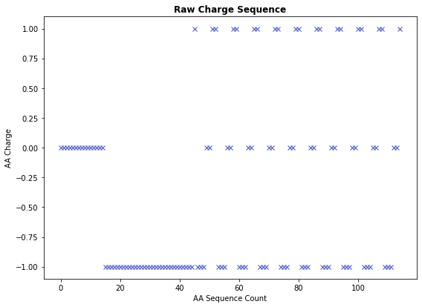
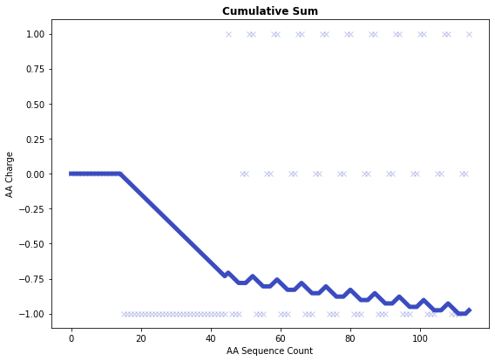
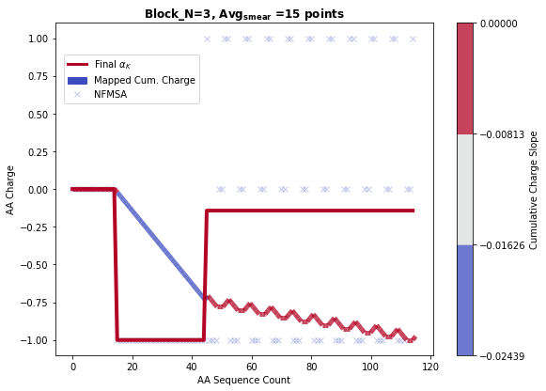
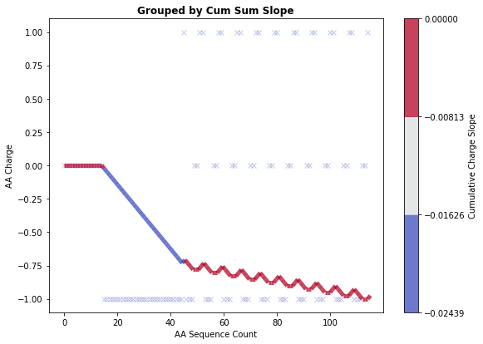
Protein Coarse-graining
Coarse-graining performed by grouping charges based on contributions to the slope of the cumulative charge
Hyperparameters: Number of bins, Minimum number of AA per block
Sample sequence:
HHHHHHHHHHHHHHH DDDDDDDDDDDDDDDDDDDDDDDDDDDDDD KDDDHHK KDDDHHK KDDDHHK KDDDHHK KDDDHHK KDDDHHK KDDDHHK KDDDHHK KDDDHHK KDDDHHK

Slide 15



Application to NFH, pH 2.4

Slide 16
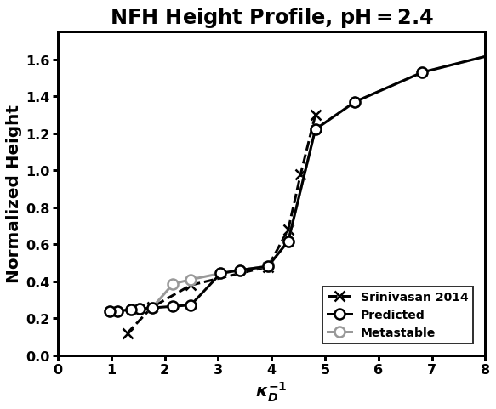

Cooperative Collapse of the Dilute Phase
What changes are occurring within NFH during 3x decrease?
Dramatic collapse
Cooperative collapse

Slide 17

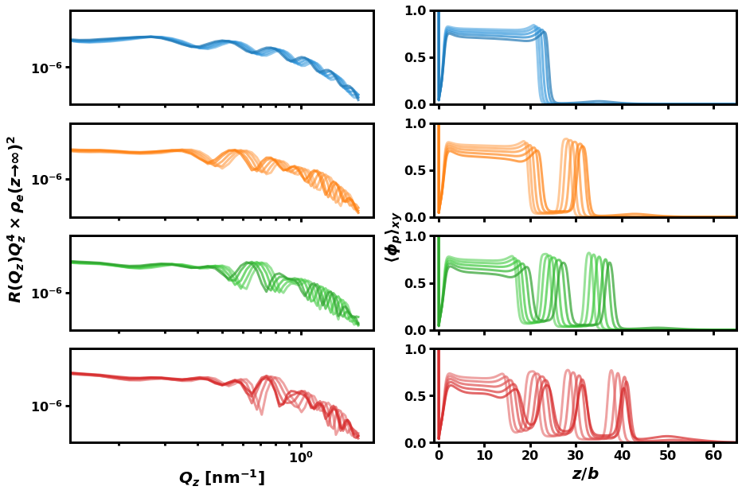

Reflectivity
X-ray and neutron reflectivity
Direct information on polymer internal structure
Prior knowledge of possible conformations necessary
Master Equation
(Reinhardt, et. al. Macromolecules, 2013)

Slide 18
Future Work

Slide 19
Summary

Slide 20
Acknowledgements

Slide 21
Summary
Paste from above

Slide 22
Supplemental Slides

Slide 23
SI: Table of Contents

